Slide 1
Power Rangers
Five AI personas stress-test your business idea before you build it.
Built by Ashupriya Sadanande

Slide 2
SECTION 01 · PROBLEM
01
The Problem & The User
Who is your user?
Early-stage founders and operators who are serious about an idea but haven't built anything yet.
What is the pain, in one sentence?
They fall in love with their own idea and only get real, critical feedback after they've already spent months building it.
What do they do today, and why does it fall short?
They pitch friends and mentors, or ask a generic AI — both tend to validate rather than challenge, so blind spots survive all the way to launch.

Slide 3
SECTION 02 · INTENT
02
User Intent
“When I ____, I want to ____, so that ____.”
“When I have a business idea I'm serious about, I want it stress-tested from five different angles — logic, execution risk, founder judgment, my own psychology, and investor scrutiny — so that I only commit real time and money after it has survived real pressure.”

Slide 4
SECTION 03 · SOLUTION
03
What I Built
Product summary (3–4 sentences):
Power Rangers runs one business idea through five distinct AI personas — First Principles, Devil's Advocate, Founder, Therapist CEO, and Contrarian Investor. Each Ranger's full output feeds automatically into the next, so the personas are actually debating the same idea rather than repeating generic advice. There's no manual copy-pasting between phases — the user submits one idea and watches all five run end to end.
The core flow, step by step:
1. User types a business idea (or picks a sample) and hits "It's Morphin' Time."
2. Each Ranger runs in sequence, streaming its live thinking, then passes its full output as context into the next Ranger.
3. User gets a complete five-perspective strategic report they can read end to end and download.

Slide 5
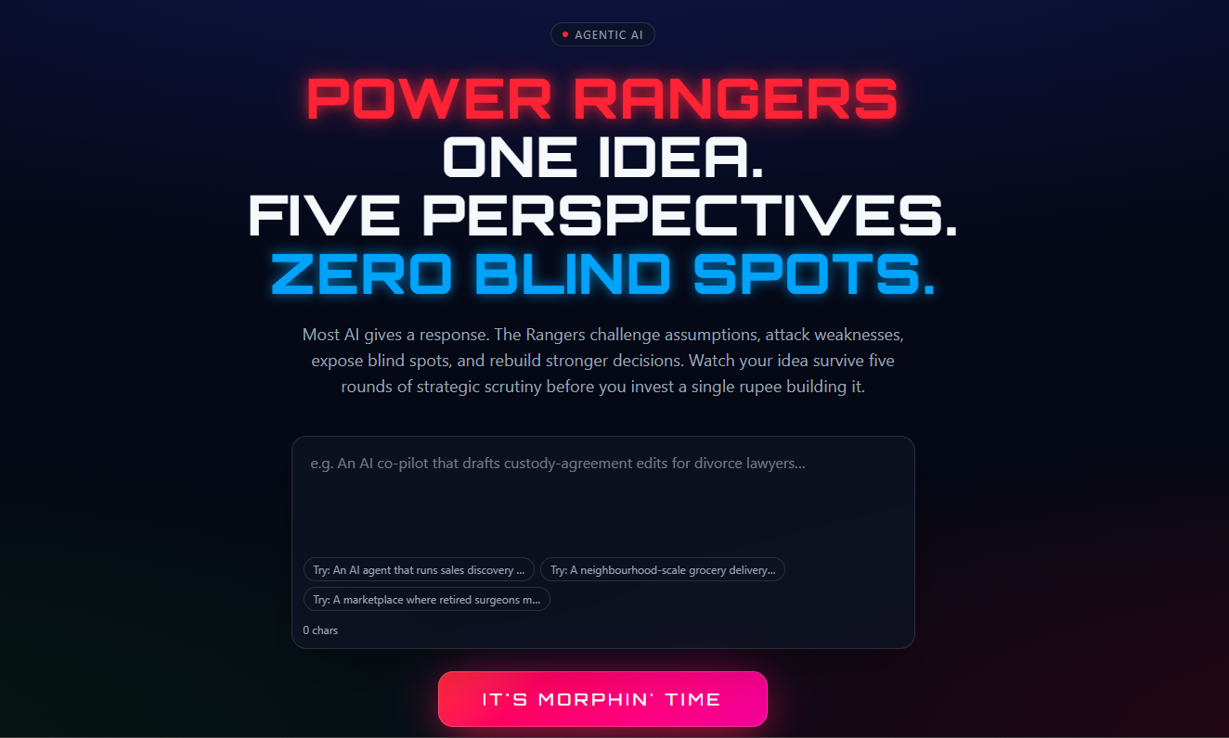
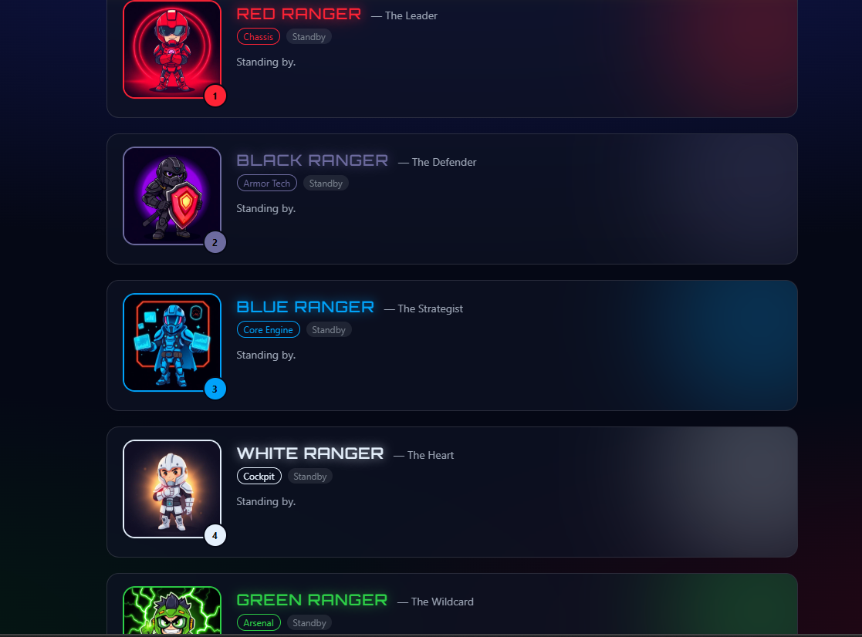
SECTION 04 · DEMO
04
Live Demo
Live URL: https://ranger-vision-engine.lovable.app/
Traction: 57 early-stage founders have run their idea through Power Rangers since launch.

Slide 6
SECTION 05 · AI
05
How AI Powers It
Model used: Claude (Anthropic API) — chosen for visible extended thinking and reliable long-context handling, since each Ranger must reason over every prior Ranger's full output.
What the AI actually does:
Each Ranger reasons in character — from a distinct system prompt and mode — interrogating assumptions, attacking the plan, deciding like a founder, diagnosing psychology, or pricing risk like a VC, using the full prior chain as context.
Your key prompt (paste it!):
"Enter Devil's Advocate Mode. Find every reason this idea fails. Be ruthless. Don't soften anything. After tearing it apart, tell me what would need to be true for it to actually work." (one of five Ranger prompts, chained)
Context you feed it:
Ranger 1 gets the user's raw idea. Every Ranger after that gets the full text output of every Ranger before it, so the chain of context never breaks.

Slide 7
SECTION 06 · STACK
06
Architecture & Stack
Stack: Lovable (frontend + hosting) + Claude API (Anthropic, streaming + extended thinking) + a sequential orchestration layer that chains the five Ranger prompts
Flow: User idea → Lovable frontend → Claude API (Ranger N, streaming) → output appended as context for Ranger N+1 → repeat ×5 → compiled report in UI
User's Idea
Lovable Frontend
Claude API — 5 Chained Rangers
Report + Download

Slide 8
SECTION 07 · DECISIONS
07
Key Decisions & Trade-offs
Decision 1: Full auto-chaining over manual copy-paste between phases
Why: manual handoff between phases breaks the "five perspectives against one idea" experience — automation isn’t a nice-to-have here, it’s the actual product.
Decision 2: Show live thinking during processing over an instant, hidden output
Why: watching each Ranger visibly "argue" builds trust in the critique and makes the multi-model wait feel intentional, not slow.
Decision 3: Five fixed personas over one configurable "critique" prompt
Why: distinct personas force genuinely different angles — logic vs. execution vs. psychology vs. capital — instead of one blended, watered-down opinion.
What surprised you while building:
Sequencing mattered more than any single prompt — the sharpest insights only showed up once a Ranger had all prior Rangers' output to react to, not the raw idea alone.

Slide 9
SECTION 08 · SCOPE
08
What I Cut
Cut: user accounts / saved history — because early users just want one report per session, not a login wall.
Cut: manual editing of a Ranger's output before it feeds the next phase — because it reopens the manual-handoff problem Decision 1 solved.
Cut: letting users choose which Rangers to run — because the value is watching all five clash on the same idea; skipping one undercuts the product.
Every cut kept the five-Ranger core loop rock solid instead of five features shipping half-built.

Slide 10
SECTION 09 · METRICS
09
How I'd Measure Success
North Star: % of sessions that reach a completed 5-Ranger report (the idea survived the gauntlet and the founder got real value)
Supporting metrics:
1. Idea-input length/specificity — a proxy for how seriously a founder engages before hitting run
2. Return usage — founders running a second idea, or the same idea again after revising it
Guardrail metric: time-to-first-Ranger-output must not regress as more Rangers or reasoning depth get added
How you'd instrument it: session start, per-Ranger completion + time, report download/copy, repeat-session by returning visitor

Slide 11
SECTION 10 · NEXT
10
What I'd Build Next
Next up: Let founders push back on a Ranger mid-pipeline before the next one runs, without breaking full automation for those who just want to run it straight through
Why this next: several of the 57 early founders have asked to argue back with the Devil's Advocate Ranger before Founder Mode responds with Loop Engineering
Evidence that would trigger it: repeat sessions and mid-report drop-off clustering right after the Devil's Advocate phase
Longer term: a running board of AI advisors founders return to over an idea's life, not just a one-time pre-build gauntlet

